Slide 1
The Civil War in China and the Japanese Invasion

Slide 2
Chinese Civil War
In 1912, the Qing dynasty crumbled, ending imperial rule in China. The ensuing political, social and economic chaos led to the formation of two main factions.
The Nationalists were led by Chaing Kai-shek.
The Communists were led by Mao Zedong.
At first, the two factions worked together against warlords, however, the Nationalists soon turned on the Communists. This led to a nearly ten-year Chinese civil war which lasted until 1937.

Slide 3
Nationalists Believe the people should not have to live under the control of the government.
Communists Believe the government should have control over property and economy.

Slide 4
Japanese Invasion of China
Japan invaded China in 1937.
The Chinese Nationalists and Communists declared a temporary truce and fought together against the Japanese.
People fled to the city of Nanking to escape the Japanese troops.

Slide 5
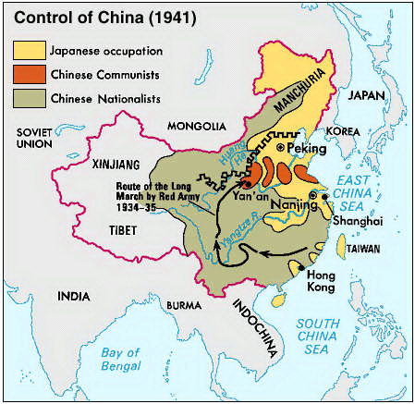

Slide 6
Nanking Massacre
December 1937
Japan launched a six week assault of unarmed civilians in the city of Nanking.
Looting, rape, torture, and mass killings led to an estimated death toll of 350,000 Chinese citizens.
Japan never took full responsibility for their actions which remains, to this day, a stumbling block in the relationship between the two countries.

Slide 7
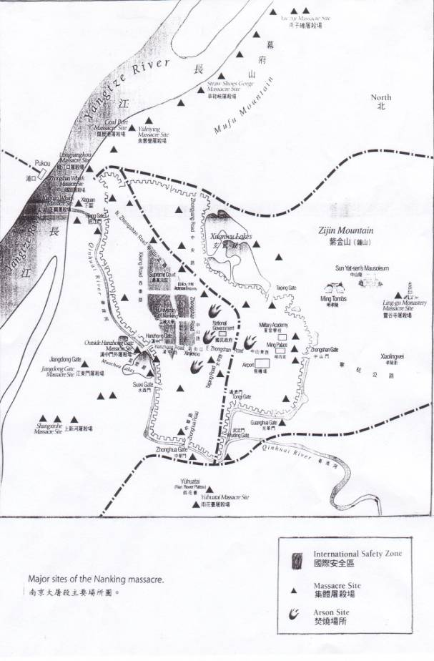
Massacre Sites

Slide 8
Anti-Japanese Sentiment in US
Influx of Japanese immigration to the west coast in the late 19th century.
Japanese immigrants were willing to work for less wages causing Americaworkers to feel financially threatened.
In the 20th century, the US government did not agree with the aggressive nature of Imperial Japan.
As a result, the US supported the Chinese government in their war against Japan.

Slide 9
Attack on Pearl Harbor
On December 7, 1941, Japan bombed Pearl Harbor, a US naval base on the island of Oahu, Hawaii.
Within two hours, 20 US naval vessels and 200 airplanes were destroyed.
Two Thousand US soldiers and sailors were killed while 1000 were wounded.
In response, President Franklin D. Roosevelt gained full support from the Congress to declare war against Japan. It was then that the US entered World War II.

Slide 10
US Response to Pearl Harbor
February 1942, President Roosevelt issued Executive Order 9066
This allowed the federal government to ban citizens from living in certain areas, mainly within 50-60 miles of the coast stretching from Washington through California.
It also allowed for the transportation of citizens to assembly centers managed by the military in California, Arizona, Washington, and Oregon.

Slide 11
Relocation of Japanese-Americans
In March 1942, President Roosevelt signed Executive Order 9102 which established the War Relocation Authority which gave the government permission to “relocate” Japanese Americans.

